Slide 1
NMBP 27-2016 Promoting Safe innovation through global consolidation and networking of nanosafety centres and strengthening the European nanosafety cooperation Martie van Tongeren
Director of Research
Thematic brokerage workshops
Workshop 7: EU-U.S Cooperation
EU Brokerage Event on Kets in Horizon 2020
Strasbourg, 1st October 2015

Slide 2
Overview
Background to IOM and our expertise
Description of the call
Existing initiative

Slide 3
Who we are…
The IOM is an independent provider of scientific, medical and technical services, principally in occupational health
A registered Scottish charity and social enterprise
Customers include government departments, local authorities, industry associations, professions and private sector companies
Established in 1969, and independent since 1990

Slide 4
IOMs main research interests
Safety of nanomaterials
Toxicology, Exposure assessment and Risk assessment
Environment and Public health
Air pollution, Risk assessment, Health impact assessment, Environmental influences on child health, Pesticides
Chemicals and human health
Industrial chemicals and the EU REACH regulations, Dermal and inhalation exposure, Epidemiology, Occupational cancer
Workplace interventions and evaluations
Stress, Musculoskeletal risks, the effectiveness of regulatory interventions
Work and the aging population
Systematic reviews of the scientific literature on work and health

Slide 5
IOM Singapore
Company registered in Singapore www.iom-world.sg
Subsidiary of IOM in UK
Research, consultancy and training in occupational and environmental health safety and risk, strong focus on nano
IOM Singapore is the Nanofutures lighthouse in SE Asia
IOM Singapore staff (Rob Aitken, Michael Riediker) have previously participated in multiple EC projects e.g. Marina, Nanex, Nanofutures, Observatorynano, NanoImpactNet
Organisers of IPTC 2016
Co-ordinator of Singapore research network nanOsing.sg

Slide 6
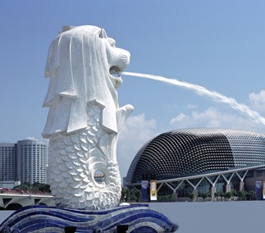
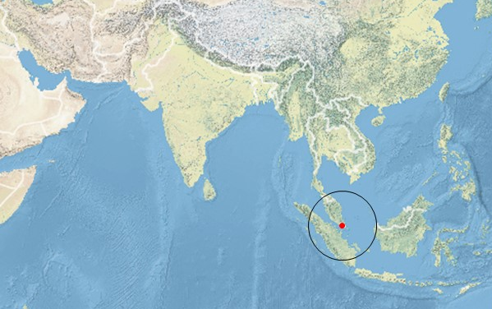
Singapore: The “Little Red Dot” in SE-Asia
IOM Expertise provided in Asia

Slide 7
Nanosafety research
Involved in a wide range of research projects (FP7/H2020)
As coordinators: MARINA, ENPRA, NANEX, MODENA
Participating currently in: NANOREG, NANOREG2, PROSAFE, GUIDENANO, SUN, NANOINDEX
Expertise:
Exposure assessment and modelling
Toxicology, including in silico modelling (dose-response, PBPK, QSAR)
Risk assessment

Slide 8
Nanosafety services
SAFENANO: IOM’s Centre of Excellence supporting
Authors of several UK and European ‘flagship’ reports on nanotechnology risk, and the BSI Guides on safe handling & disposal and exposure assessment of engineered nanomaterials.
www.safenano.org
Workplace Exposure Monitoring
Assessing the Unseen Risk
Hazard Assessment & Toxicology Testing
Evaluating the Hazards with Nanomaterials and Products
Laboratory Services and Analysis
Using Characterisation to Support Risk Assessment
Risk Assessment
Duty of Care with Nanotechnology Risks
Research to Support Innovation
De-Risking New Technologies

Slide 9
EU-US collaboration
EU-US Community of Research on Exposure through Life Cycle
Co-Chairs: Paul Westerhoff (US) and Martie van Tongeren (IOM)
Increasing emphasis on release and exposure
Development of a workplan to
Exploit synergies,
Encourage data sharing,
Develop tools and methodologies
IOM has a US link through Rick Canady, who is working for IOM on PROSAFE

Slide 10
NMBP 27-2016
to support safe innovation related aspects by providing the technology, skills, and processes, necessary for science-based best NanoSafety practices in industrial and commercial activities.
The proposed CSA should aim at networking existing platforms, including the nanosafety cluster, at European level and cooperate with third countries.
1-2 Million Euros
international cooperation according to the current rules of participation is encouraged, in particular with Brazil, South Korea and the United States of America.

Slide 11
Expected Impact
An independent science based EU nanosafety reference platform for all stakeholders in nanotechnology that collates information into a comprehensive and accessible European network portal and providing a solution to the problem of data accessibility and transferability, by removing barriers which currently limit knowledge distribution;
The CSA should mark progress for Guidance to market actors (industry, safety service providers, and public authorities), best practice, standards, technical approvals, environment protection, and operational certification systems;
The platforms network should prepare a European Hub to provide services and support for stakeholders (e.g. industry, governments, researchers etc.) to create in a sustainable way marketable, societal approved products and goods;
Involvement of highly renowned actors in the research field and from leading stakeholders from regulatory bodies, standardization bodies, into a seedless dialogue;
Significant research outputs efficiently disseminated to national and international communities.

Slide 12
Closer to the Market Roadmap (CTTM)
Aims to speed up progress towards market implementation of nanotechnologies
Identify key challenges
Building inclusive collaborative network
Bringing together scientific experts
Strengthening dialogue to raise synergies
Implement risk assessment framework
Building service provider network
More information contact Andreas Falk at BioNanoNet (Andreas.Falk@bionanonet.at)

Slide 13
Preliminary consortium- “EC4SafeNano” Project
Aiming to build and demonstrate the doability, efficiency but also the sustainability of this structure gathering all capabilities and knowledge
All partners from all the nano network are welcome (those in innovation, nanosafety, training, society, expertise, characterize materials and hazard, produce RA, SEA, RM...)

Slide 14
Approach
Transferring knowledge and results gained from all actors into expertise driven operational tools
Connecting Science, regulators, industry, society
Offering public & private Service based on a common level
In order to :
Gather the available expertise
Make available reference information, best practices and SOPs
Transfer research results & Combine multidisciplinary expertise into operational tools and services
Develop EU-wide education, training, and certification
Monitor new and emerging risks
Provide feedback on research needs to upgrade expertise
Make available access to infrastructure for other organizations

Slide 15
Interested in joining EC4SafeNano project ?
Contact :
emeric.frejafon@ineris.fr
olivier.salvi@ineris-developpement.com

Slide 16
Thank you for your attention!
Martie.van.tongeren@iom-world.org

